Slide 1
Anorectal malformations
(Imperforate anus)
Orri Þór Ormarsson
Barnaskurðlæknir

Slide 2
Meðfæddir anorectal gallar
Anorectal malformation
Imperforate anus
Anal atresia
Spektrum af göllum tengdum rectum og anus
Allt frá ectopic anus til blint endandi rectum

Slide 3
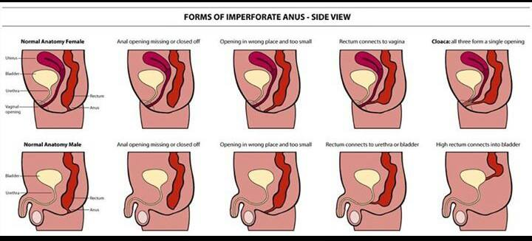
Tegundir

Slide 4
Tíðni
Nýgengi - allar tegundir = 1 af 5000 lifandi fæddum 60% í strákum
Allar gallar Male/female, = 1,4:1 - 1,6:1
Lágir gallar m/f = 1:1
Háir gallar m/f = 1,8:1
Algengari í Downs and Cat eye Syndrome
1% líkur á sama galla í næsta barni
Notes:
Cat eye syndrome chromosomal disorder that may be evident at birth
The name "cat eye syndrome" is derived from a distinctive eye (ocular) abnormality that is present in some affected individuals. This feature consists of partial absence of ocular tissue (coloboma), often affecting both eyes (bilateral). Affected ocular tissues may include the colored region (iris), the middle layer (choroid), and/or the nerve-rich innermost membrane (retina) of the eye.

Slide 5
Sögulegt yfirlit
Fyrst getið í fornum grískum heimildum
Frakkinn Amussat 1835: fyrsta analplastíkin
Douglas Stephens 1953: opna sacralt
Pena 1980 – 1982: PSARP (Posterior Sagital Ano-Rectal Plastic)
Notes:
Imperforate anus hefur verið þekkt frá því í fornöld. Fyrst er skrifað um þetta í fornum Grískum heimildum. Í margar aldir gerðu læknar einungis op í perineum og mörg þessi börn lifðu. Sennilegast hafa flest þeirra haft defect sem nú væri kallaður lár defect. Börn með háan defect lifðu ekki eftir þessa aðgerð.
Paulus Aegineta recorded the earliest account of successful surgery for imperforate anus. He suggested rupturing an obstructing membrane with the finger or knifepoint and then dilating the tract until healing was complete. This approach was used for many years.
Frakkinn Amussat, 1835, var fyrstur til að sauma rectal vegginn út á húðina og gerði hann þannig fyrstu anoplastíkina.
Á fyrri hluta þessarar aldar var algengast að gera anoplasty án þess að gera colostomíu þegar um lágan galla var að ræða. Þegar gallinn var hár var gerð colostomía og seinna abdomino-perineal pull-through. Ákvörðunin um colostomíu var byggð á rtg. rannsókn eða svo kölluðu invertogrammi.
Árið 1953 kom Douglas Stephens breti fram með aðferð sem var fólgin í að opna sacralt og gera síðan abdomino-perineal aðgerð ef nauðsynlegt reyndist. Hans tilgangur með sacral stiginu var að varðveita puborectal lykkjuna sem álitin var leika lykilhlutverk í sambandi við continence.
Posterior sagittal (PSARP) methóðan var fyrst notuð í sept. 1980 og publiceruð 1982. Við þessa aðferð sést öll anatómían mun betur en við fyrri aðferðir.

Slide 6
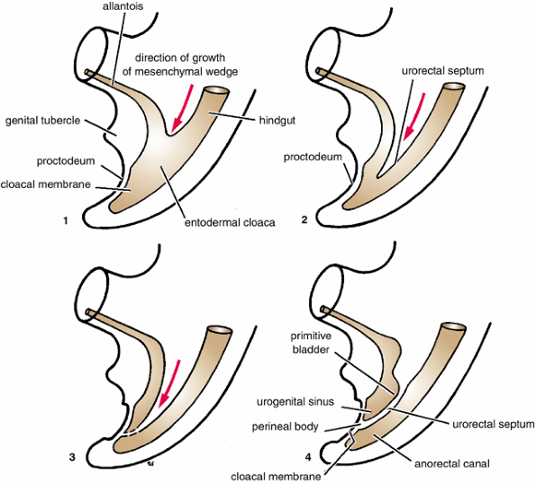
Orsök óþekkt
Á um 8 viku skiptist cloacal membrane í urogenital and anal hluta
Galli í myndun eða formi posterior urorectal septum tengist sennilega flestum göllunum
Notes:
The etiology of such malformations remains unclear and is likely multifactorial. There appears to be a low rate of association in families, but some appear to have an autosomal dominant inheritance pattern with a high incidence, as much as 1 in 100. Chromosome 7q39 has three important loci, which are implicated for development of ARM, these include genes: SHH, EN2, and HLXB9. Some studies demonstrated several mutations of HLXB9 associated with ARM.[2] Few syndromes with autosomal dominant mode of inheritance such as Townes-Broks syndrome, Currarino's syndrome, and Pallister-Hall syndrome are associated with ARM.[3]

Slide 7
Greining
Prenatalt
polyhydramnion, intraabdominal cystur (í fóstrinu)
Greining á anal atresiu fæst við skoðun
  Anus ekki til staðar
  Ectopiskt anal op
  Perineal-og/eða recto-vestibular fistlar sjást oftast auðveldlega
  Röntgen (eftir 24t)
Notes:
Prenatal ultrasonography examination findings are often normal, although the polihydramnion or intraabdominal cysts may suggest imperforate anus with associated hydrocolpos or hydronephrosis.
Bíða í 24 t með anograf til að fá upp þrýsting

Slide 8
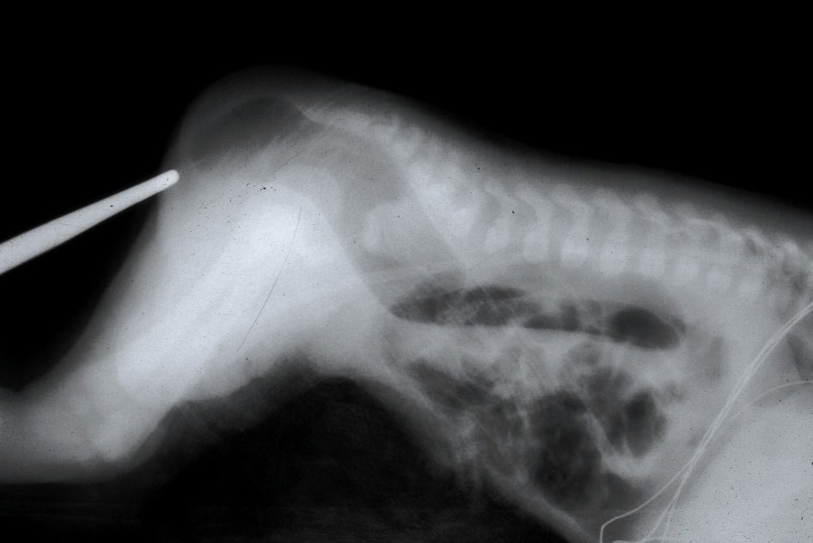
Loft-anogram
Notes:
Bíða í 24 t til að fá upp þrýsting

Slide 9
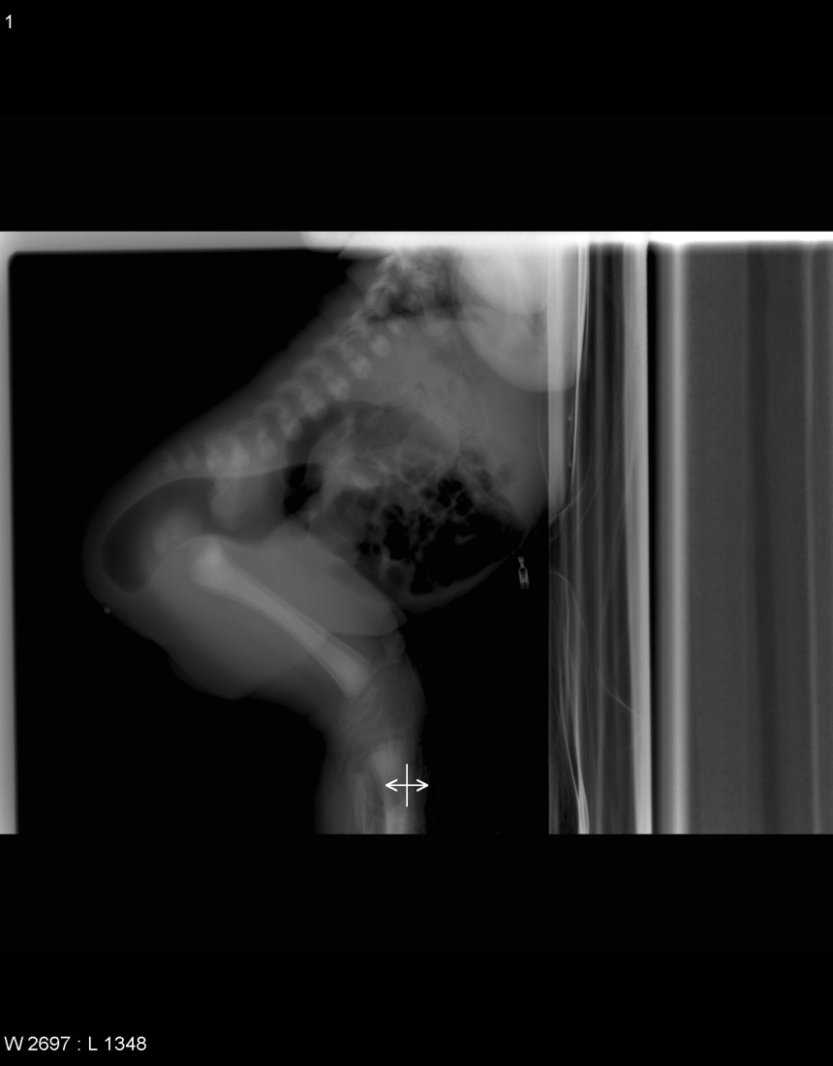

Slide 10
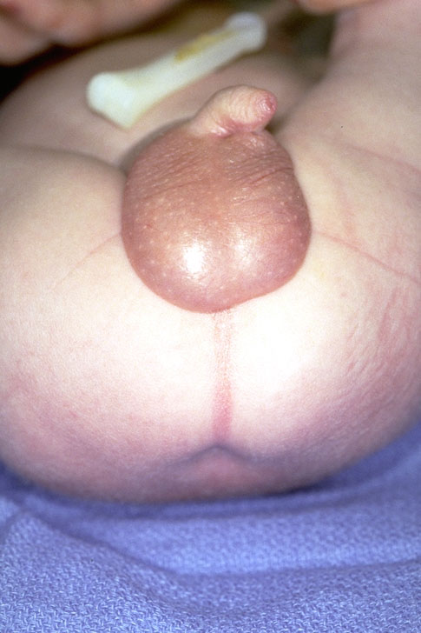

Slide 11
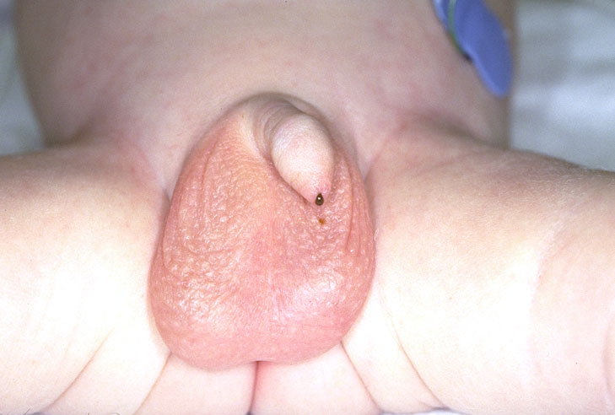

Slide 12
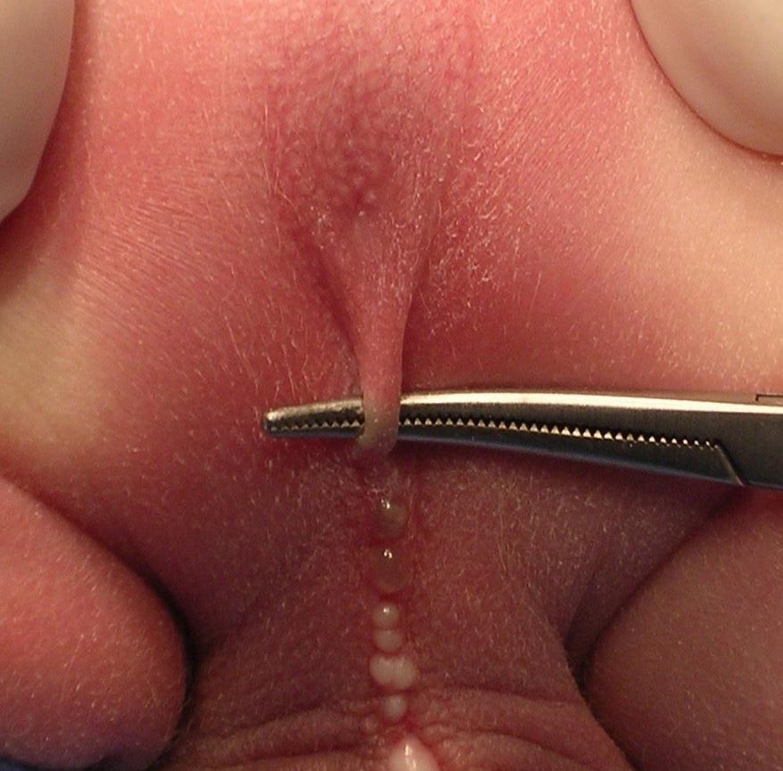
Bucket handle
Notes:
In males, the perineum may exhibit other features that help in recognition of this defect, such as a prominent midline skin bridge (known as 'bucket handle') or a subepithelial midline raphe fistula that looks like a black ribbon because it is full of meconium.

Slide 13
Vestibular fistula

Slide 14
Algengustu tegundir galla
Oft talað um háa og lága galla eftir staðsetningu fistils
Háir gallar
strákar: recto-urethral fistula
stelpur: recto-vaginal fistula
Lágir gallar
strákar: recto-perineal fistula
stelpur: recto-vestibular fistula

Slide 15
Flokkun
Anomaliurnar eru margvíslegar
Mörg flokkunarkerfi verið í notkun.
Nýjasta kerfið flokkar sjúklingana eftir kyni og hvort colostomia er ráðleg eða ekki.
  Greinir einnig á milli hvar fistillinn er en það hefur mestu áhrif á horfurnar.
Notes:
There has always been a need for classifying these anomalies in order to decide the management and predict the final outcome. The earliest classification of ARM was based on the position of the terminal bowel in relation to the levator ani or pelvic floor.[4] Wingspread classification was established according to the level of the arrest of rectal descent and patient's sex [Table 1].[5] This classification was widely accepted and was used for many years. After the advent of posterior sagittal approach by Peña et al., it was realized that the site of fistula has an important bearing on the long-term outcome of these patients.[6] Peña proposed a classification in 1995 based on the presence and position of the fistula as a result of his experience with the posterior sagittal anorectoplasty (PSARP) [Table 2].[7,8] The position of the fistula was used to determine operative management. Although PSARP soon became the operation of choice, the results of the studies comparing the long-term outcome between PSARP and other classical operations were highly variable.[9] This was supposed to be due to the variation in the follow-up criteria used in different studies. To standardize the methodology for evaluation of outcome of patients with ARM Krickenbeck group came with their classification.[10] The Krickenbeck classification system incorporated criteria from the Wingspread and Peña's classification. It comprised of three distinct elements: A diagnostic category, a surgical procedure category, and a category documenting functional outcome criteria [Tables ​[Tables3a3a-​-c].c]. The Krickenbeck classification also gave equal emphasis to both constipation and soiling compared with previous scoring systems which hardly took constipation into account.

Slide 16
Flokkun (Wingspread Classification 1984)
Male
High
  Anorectal agenesis
with rectourethral (prostatic)
fistula
Without fistula
  Rectal atresia
Intermediate
  Rectobulbar urethral fistula
  Anal agenesis without fistula
Low
  Anocutaneous fistula
  Anal stenosis
  Rare malformations
Female
High
  Anorectal agenesis
    With rectovaginal fistula
    Without fistula
  Rectal atresia
Intermediate
  Rectovestibular fistula
  Rectovaginal fistula
  Anal agenesis without fistula
Low
  Anovestibular fistula
  Anocutaneous fistula
  Anal stenosis
  Cloacal malformation
  Rare malformations
Notes:
according to the level of the arrest of rectal descent and patient's sex

Slide 17
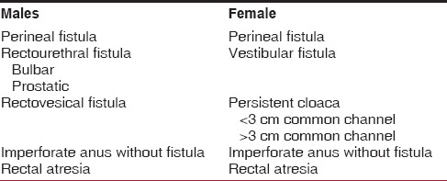
Flokkun (Peña)
Notes:
Peña proposed a classification in 1995 based on the presence and position of the fistula as a result of his experience with the posterior sagital anorectoplasty (PSARP) [Table 2].[7,8] The position of the fistula was used to determine operative management

Slide 18
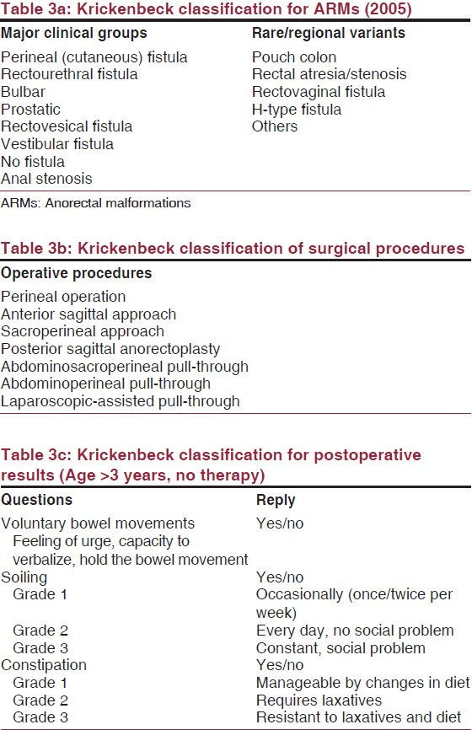
ARM Krickenbeck group
Notes:
To standardize the methodology for evaluation of outcome of patients with ARM Krickenbeck group came with their classification.[10] The Krickenbeck classification system incorporated criteria from the Wingspread and Peña's classification. It comprised of three distinct elements: A diagnostic category, a surgical procedure category, and a category documenting functional outcome criteria [Tables ​[Tables3a3a-​-c].c]. The Krickenbeck classification also gave equal emphasis to both constipation and soiling compared with previous scoring systems which hardly took constipation into account.

Slide 19
Flokkun
Perineal fistula
Vestibular fistula
Cloaca
Bulbar urethral fistula
Prostatic urethral fistula
Bladder-neck fistula
Absent fistula
Cloacal exstrophy
Notes:
Imperforate anus was historically classified based on the position of the distal-most aspect of the colon in relation to the levator ani muscles. Malformations at or above the levator muscle complex were defined as high anomalies. Infralevator lesions were termed low and were considered simpler and were associated with better prognosis. This system was based on the now obsolete Wingspread classification.
Information obtained from the posterior sagittal approach has led to an anatomic classification that lists malformations based on their specific anatomy. The following is a list of the most common malformations:
Perineal fistula
This malformation is associated with good prognosis, occurs in either sex, and involves a closed anus with a small connection opening on the perineal body.
Some babies with this malformation have a small loop of skin at the anal opening that resembles a bucket-handle. This is pathognomonic for perineal fistula.
Some boys may have no visible perineal opening but may accumulate mucous or meconium in the fistula, which can extend up the median raphe of the scrotum and resembles a black cord (meconium) or a string of pearls (mucous).
This malformation is amenable to primary neonatal pull-through.
Healthy girls who have normal-sized anal openings and small-appearing perineal bodies do not have perineal fistula. This is easily determined by measuring the size of the anus using Hegar dilators. The anus of an average-term newborn should be approximately 12 mm but varies with the size of the child. The "correct" size of the perineum is largely a matter of experience.
Vestibular fistula
This malformation is associated with good prognosis and is easily diagnosed upon physical examination based on the appearance of a small opening at the posterior aspect of the vestibule. The opening is external to the hymen and is, therefore, not vaginal.
The term vaginal fistula was commonly and incorrectly used to describe vestibular fistula. True solitary congenital rectovaginal fistula is exceedingly rare.
Vestibular fistula is safely treated with diverting colostomy, although some pediatric colorectal surgeons repair this malformation primarily in the newborn period without using colostomy.
Cloaca
Persistent cloaca is a malformation in females that encompasses a spectrum of defects, including the presence of a common channel that incorporates the urethra, vagina, and rectum.
The length of the common channel correlates with complexity and prognosis. Shorter channels (< 3 cm) have fewer associated malformations and carry a better prognosis. Longer channels have more complex malformations and poorer prognosis.
One half of all girls with this malformation have 2 hemivaginas and many have hydrocolpos.
This malformation is easily diagnosed upon physical examination based on the presence of a solitary perineal orifice. Females with this malformation often have very small-appearing labia.
All children with cloacae should undergo colostomy shortly after birth.
Bulbar urethral fistula
This malformation observed in boys is relatively common.
No fistula is observed upon physical examination, and urinalysis often shows meconium.
Colostomy is essential to relieve obstruction, prevent urinary soiling, and to allow for distal colostography, which clarifies the malformation for definitive surgical repair.
Prostatic urethral fistula
This malformation observed in boys is rarer than bulbar fistula and carries a poorer prognosis.
The diagnosis and treatment algorithm are identical to those of bulbar fistula, although the surgical procedures used differ.
Bladder-neck fistula
This rare malformation observed in males (10% of all malformations in males) carries a very poor prognosis.
Most patients with bladder-neck fistula require bowel-management regimens.
The diagnosis and treatment algorithm are identical to those of bulbar and prostatic fistulas, although the surgical procedures used differ.
This fistula is best approached abdominally.
Absent fistula
This malformation can occur in either sex, is somewhat rare, and is associated with a good prognosis. It is commonly associated with trisomy 21.
Diagnosis is primarily by exclusion.
Lateral pelvic radiography is performed in babies who have no external evidence of fistula, who pass no meconium after 24 hours, and who have no meconium in the urine.
If the pelvic rectal pouch is within 1 cm of the anal dimple, a primary pull-through may be performed. In these instances, a fistula is unlikely but should be definitely excluded using the proper surgical technique.
If the surgeon opts for colostomy, the absence of a fistula is confirmed using distal colostography.
Cloacal exstrophy
This extremely rare malformation can occur in either sex but is most common in boys. It encompasses a spectrum that includes variant forms of covered exstrophy. The classic form is devastatingly complex.
Affected children have an omphalocele and a large extrophied cloacal plate on their lower abdominal wall. They have 2 hemibladders separated by an intestinal plate, often with prolapsed terminal ileum that proceeds distally to include an extrophied urethral plate flanked by 2 hemiphallic or hemiclitoral structures.
All children with cloacal exstrophy have some degree of pubic symphysis diastasis and may have a spinal malformation, most commonly myelocystocele.
Thankfully, this complex malformation is rare but it has devastating implications on quality of life.

Slide 20
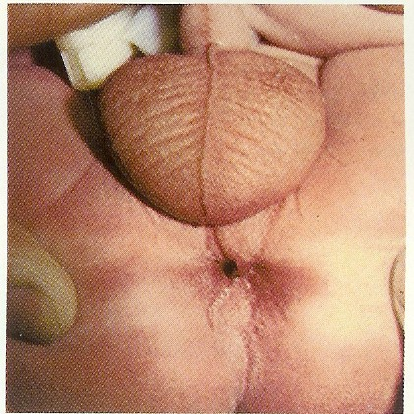
Strákar: Recto-perineal Fistulas
“low defect” góð prognosa
Rectum er að mestu innan sphincter mechanism. aðeins neðsti hlutinn liggur anteriort
Stundum opnast þetta ekki beint út heldur fylgir subepithelial miðlínu gangi, og opnast mun framar, jafnvel á penis.

Slide 21
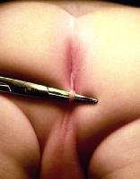
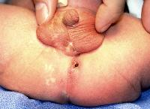
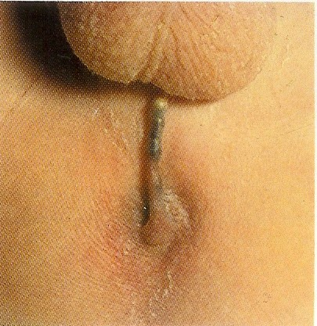

Slide 22
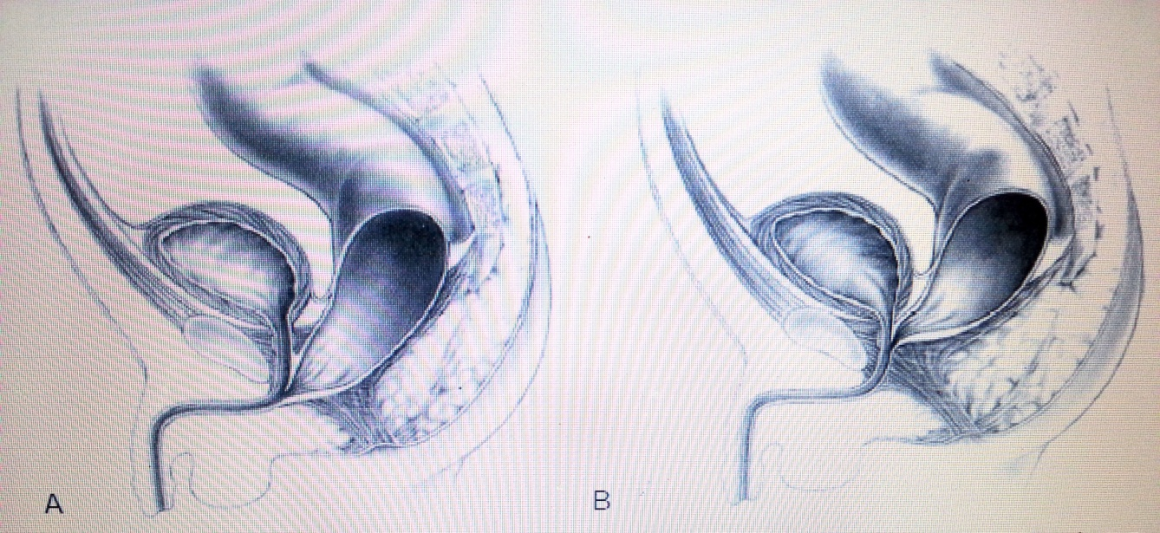
Strákar: Recto-urethral Fistulas
Algengasti hái gallinn í strákum
Fistillinn endar í :
  Bulbar hluta urethra –lægri vel þroskaður vöðvakomplex, vel þroskað sacrum og “prominent midline groove” og “anal dimple”.
  Prostatic hluta urethra
  Hærri illa þroskaður vöðvakomplex, óeðlilegt sacrum og flatur, rass og perineum.

Slide 23
Strákar: Recto-bladder Neck Fistulas
Léleg prognosa
  illa þroskaður vöðvakomplex, óeðlilegt sacrum, flatur rass og perineum.
  Um 10% af göllum hjá strákum

Slide 24
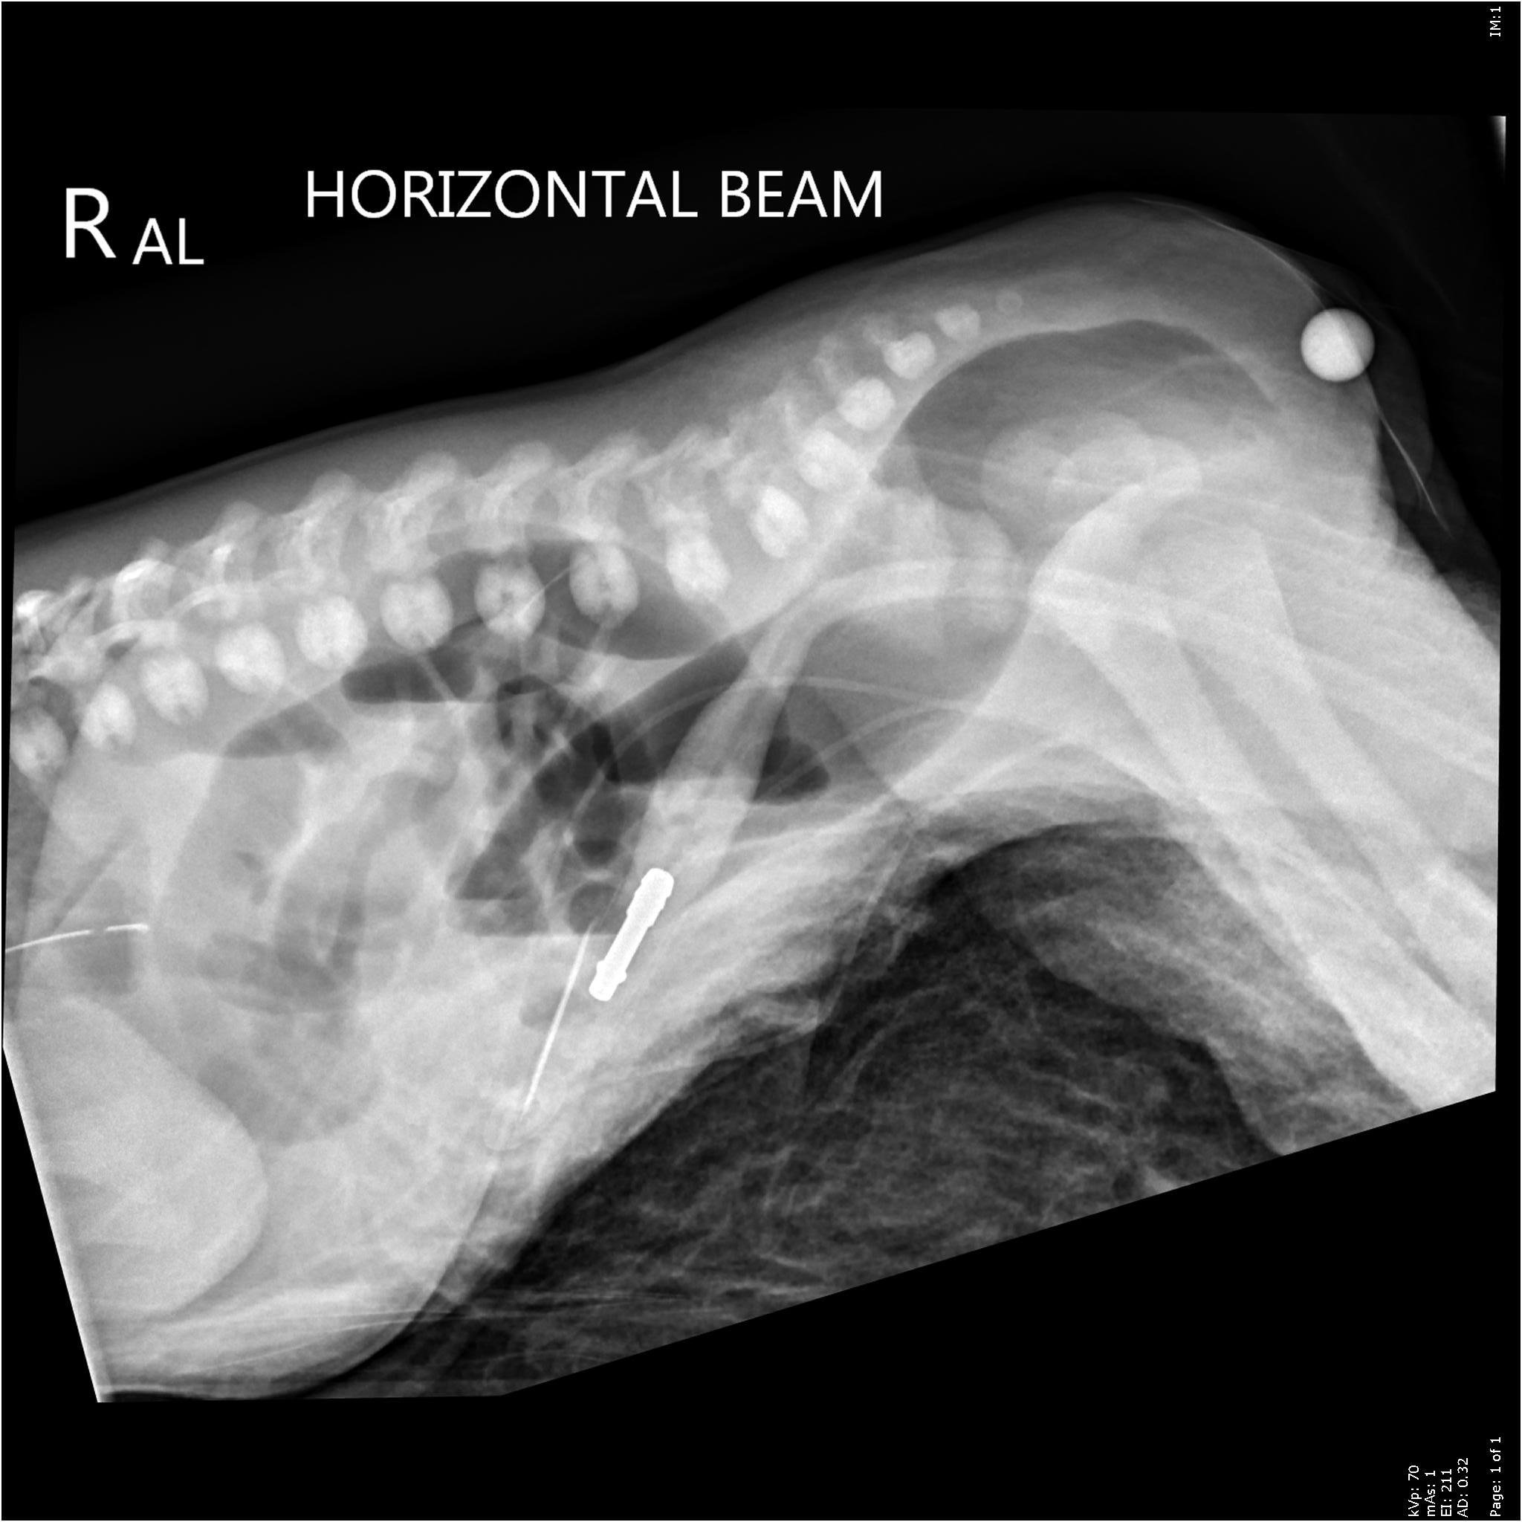
Imperforate Anus without Fistula
Merkilegt nok hfa þessir einstaklingar vel þroskað sacrum og “vel þroskaður vöðvakomplex” og því ágætis prognosu
Rectum endar yfirleitt um 2 cm innan við húðina

Slide 25
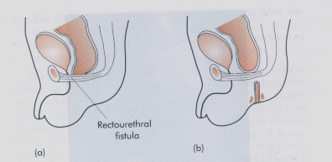
Rectal Atresia
Mjög sjaldgæft <1% góð prognosa. Vel þroskaður anal canall eðlilegt skyn í anorectum
lumen rectum er algjörlega lokað (atresia) eða að hluta(stenosis).
Efri hlutinn er víkkaður, en lægri hlutinn er myndaður af þröngum anal canal sem er yfirleitt 1-2 cm á lengd.
Aðskilið með þunnri himnu af þykkum fibrous vef.

Slide 26
Stelpur: Recto-perineal Fistulas
“low defect”
Góð prognosa
Rectum er að mestu innan sphincter mechanism. aðeins neðsti hlutinn liggur anteriort
Rectum og vagina vel aðskilin

Slide 27
Stelpur: Recto-vestibular Fistulas
“low defect”
Góð prognosa
Rectum er að mestu innan sphincter mechanism.
Aðeins neðsti hlutinn liggur anteriort

Slide 28
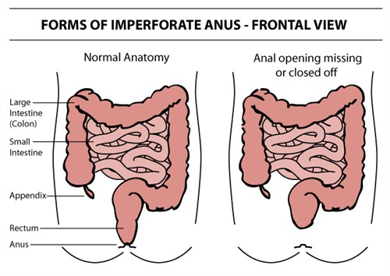
Imperforate Anus without Fistula
Samskonar prognosa og hjá strákum

Slide 29
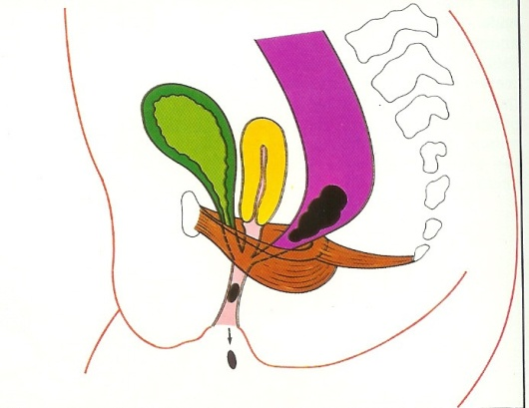
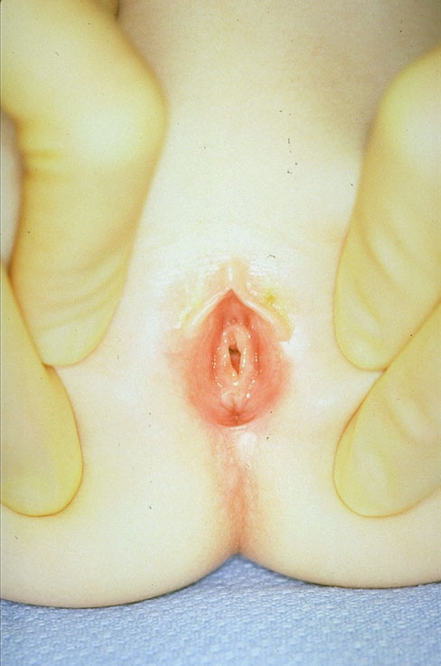
Stelpur- (Persistent) Cloaca
Rectum, vagina og þvagvegir mætast og mynda eina sameiginlega rás. Klínísk greining. Gruna ef enginn anus og lítil ytri kyfæri.Lengd sameigiunlega gangsins hefur áhrif á prognosuna. Stuttur ef < 3 cm, annars talað um langan

Slide 30
Meðfylgjandi gallar
Í um 50% tilfella
því verri galli því meiri líkur á meðfylgjandi göllum
Algengast gallar í hrygg (taugar eða bein) og genitourinary kerfinu
VACTERL association
Notes:
Samband milli imperforate anus og galla í genitourinary kerfinu er skv. rannsóknum 26-35%. Því hærri sem lesionin er þeim mun meiri líkur er á genitourinary göllum.
Mynd.
Spinal anomaliur skiptast í 2 tegundir þ.e. bein (30-44%)- og tauga (18-36%) anomaliur. Það getur t.d. vantað heil segment í sacrum. Þá getur mænan verið adherent (tethered) á slíkum stað. Þetta getur svo hindrað retraction mænunnar þegar einstaklingurinn vex. Rannsóknir eru spinal sónarskoðun eða MRI á eldri börnunum.

Slide 31
Meðfylgjandi gallar
VACTERL association
Hjarta æðakerfi 12-22%
Tetrology of Fallot
VSD
Meltingakerfi
Tracheo-esophageal abnormality 10%
Duodenal atresia 1-2%
Hirschsprung’s
Hryggur
25% ef hár galli
þar af beinagalli (30-44%) taugagalli (18-36%)
Þvag og kynfæri
60% ef háir gallar, 20% ef lágir gallar
81% ef cloaca
52% ef blöðru háls fistill
Notes:
The VACTERL association (also VATER association) refers to a recognized group of birth defects which tend to have a non-random occurrence (see below). Note that this pattern is a recognized association, as opposed to a syndrome, because there is no known pathogenetic cause to explain the grouped incidenc.
V - Vertebral anomalies
A - Anorectal malformations
C - Cardiovascular anomalies
T - Tracheoesophageal fistula
E - Esophageal atresia
R - Renal (Kidney) and/or radial anomalies
L - Limb defects

Slide 34
Meðferð
Fasta
Næring í æð
Sýklalyf
Mat/uppvinnsla á meðfylgjandi göllum
  Magasonda ef grunur um esophageal atresia
  Hjartaómun
  RTG hryggur
  Ómun af mænu tethered cord?
  Ómun af kvið m.t.t. nýrnagalla
  Þvagprufu
  Ákveða innan 24 t. colostomi v/s primer aðgerð
Notes:
An USS of the abdomen and urinary tract is particularly important in cloaca due
to the high incidence of hydrocolpos and the potential for urinary tract
obstruction, and associated urinary tract abnormalities

Slide 35
Management
Newborn Female Anorectal Malformation

Slide 36
Aðgerðir
Colostomíur-ef þarf
  Best er að gera stomiu á mörkum desc. og sigm.
  Kostir: 1. Lítil hætta á prolaps í proximala opinu.
    2. Minni hætta á “spill over”
    3. Nægileg lengd er fyrir “pull-through” síðar
Anoplasty
Pull-through
PSARP

Slide 37
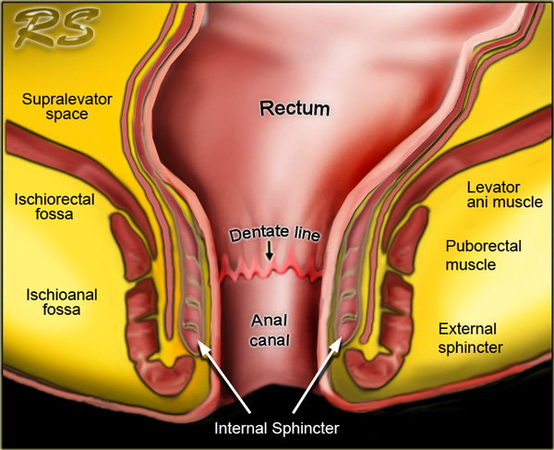
Anatomia

Slide 38
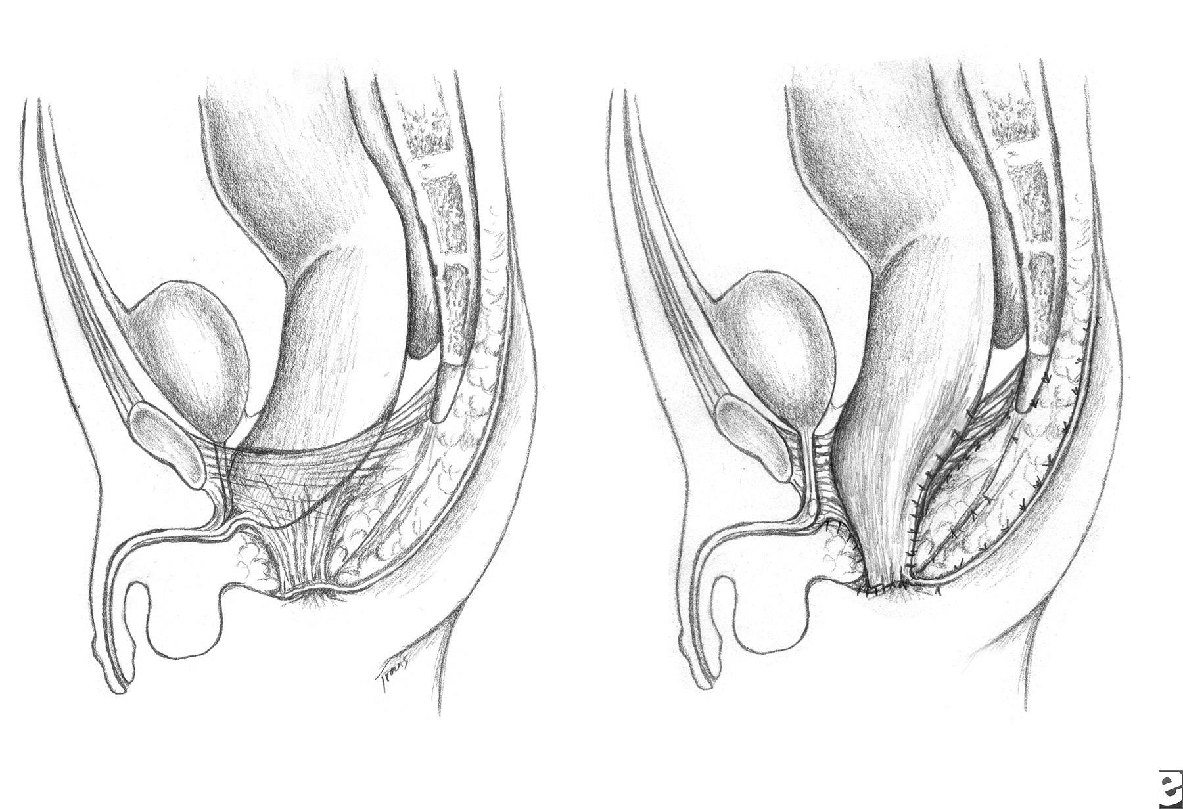

Slide 39
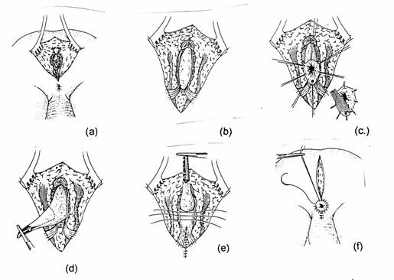
PSARP
Notes:
PSARP involves:
• Stimulation of muscles to demonstrate the midline and sphincter
• Posterior sagittal incision - length depends on severity of abnormality and
required extent of dissection
• Rectum identified. Abdominal approach may be required in addition in 10% of
males and 40% of cloacae
• Rectum dissected
• Separation from genitourinary tract - often the most difficult part
• Repositioning the neoanus within the sphincteric mechanism

Slide 40
Eftir aðgerð
Anal dilatation
Loka colostomíu
Komplicationir
Incontinence
Hægðir: leki, hægðatregða
þvag: sýk, leki
Notes:
Complications of posterior sagital anorectoplasty
There are several complications related to operative intervention and repairs of anorectal malformations in general.
Wound infection in the immediate postoperative period can occur and, fortunately, usually affects only the skin and subcutaneous tissue. All heal secondarily without functional sequelae.
Anal strictures may be the consequence of failure to follow the protocol of dilatations. When trying to prevent discomfort for the patient, some surgeons dilate the anus once a week, frequently under anesthesia. This protocol can eventually create a severe, intractable fibrous stricture. Strictures can also occur with devascularization of the rectum during the rectal mobilization.
Constipation is the most common functional disorder observed in patients who undergo a posterior sagittal anorectoplasty. Patients with the best prognosis have the highest incidence of constipation. Patients who underwent tapering do not have more constipation than those without a tapering procedure. Patients with a very poor prognosis, such as with bladder neck fistula, have a low incidence of constipation

Slide 41
Samantekt
Spectrum af göllum
fistill í húð….. rectum endar blint……cloaca
Prognosan og meðferð tengist tegund galla
50% hafa tengda galla, meiri líkur ef slæmir
oftast hryggur eða þvag/kynfæri
Aðgerð gerð að neðan með eða án colostomy

