Slide 1
Hirschsprung disease
congenital megacolon,
congenital aganglionic megacolon
Orri Þór Ormarsson

Slide 2
Hvað er Mb Hirschsprung
Galli í þroska ristils sem einkennist af skorti á ganglia frumum í hluta ristils, oftast í síðasta hluta
….leiðir til starfrænnar truflunar og obstructionar

Slide 3
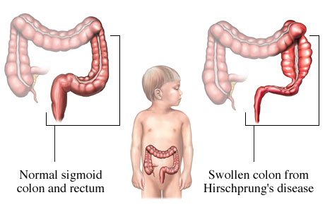

Slide 4
Saga
1691 F. Ruysch
ástandinu fyrst lýst?
1886 Harald Hirschsprung
danskur barnalæknirinn sem kom sjúkdómnum á blað
1948 Wilson og Zuelzer
lýstu því að orsökinn væri functional
1948 Whitehouse & Kernohan lýstu vöntun á ganglion frumum
Halli
Notes:
Fredericus Ruysch hollenskur anatomiker Hann lýsti 5 ára stelpu með kviðverk sem svaraði ekki þáverandi meðferð og dó að lokum
Harald Hirschsprunk dannskur barnalæknir á Queen Louise Children’s Hospital, Copenhagen, presented the most telling and concise description of congenital megacolon at the Society of Pediatrics in Berlin in 1886. His treatise was entitled “Constipation in newborns due to dilatation and hypertrophy of the colon” He presented the pathologic colon specimens and case reports of two infant boys who had symptoms of constipation soon after birth and who eventually died at 11 and 8months,respectively.
1948 Zuelzer and Wilson described the autopsy findings in 11 infants who died of Hirschsprung’s disease [193]. No mechanical cause of obstruction was noted. All 11 had absence of ganglion cells in the distal segment with six having a recognizable definitive level of obstruction. They suggested that Hirschsprung’s disease was a functional intestinal obstruction that had a congenital neurogenic basis and that an enterostomy should
be considered [193]. Also in 1948, Whitehouse and Kernohan described the autopsy findings in 11 children who
died of megacolon [184]. None had ganglion cells present and nonmyelinated nerve trunks between the longitudinal
and circular muscle layers were identified in the distal bowel.

Slide 5
Saga
1949 Orvar Swenson -lýsir fyrstu aðgerðinni:
abdominal-perianal pull-through
Svenni (og frú)
Notes:
Orvar Swenson, M.D., was born in Helsingborg, Sweden on Feb. 7, 1909. He was the third child of Amanda and Carl Albert Swenson. By the time he reached his teenage years both of his parents had died. He and his brother lived in a boarding house and started a business making fire by friction sets for the Boy Scouts. This business, "Woodcraft," grew to include archery equipment and, for a short time, field hockey sticks. (It is now a nationwide company selling equipment and tools for woodworking.)
In 1929, Orvar graduated from William Chrisman High School in Independence, MO where he had been elected President of the Student Council, was Captain of the debate Team and President of the Anti Smoking League. He graduated from William Jewell College in Liberty, MO in 1933. He then forsook the business world and entered Harvard University Medical School in Boston. He and his brother Alvin were in the same class and shared textbooks. After graduation, he served his internship at Ohio State University Hospital in Columbus, OH. He returned to the Harvard University Program at Boston Lying In Hospital for his surgical residency. He spent a year as the Tracey Cabot Fellow doing research on Hirschsprung's Disease and during that year developed a bowel resection procedure that became a cure for this disease. In 1941, he married Melva Elizabeth Criley from Independence, MO. In 1945, he became an Assistant Professor in Pediatric Surgery at Harvard University in Boston where he was a pediatric surgeon at Children's Hospital and worked with Dr. Robert Gross. In 1949, Orvar became the first Pediatric Surgeon at Tufts University, Boston Floating Hospital in Boston. In 1960, he moved his family to Chicago, IL and became the Surgeon-in-Chief at the Children's Memorial Hospital. Orvar traveled extensively demonstrating his Hirschsprung's procedure in hospitals all over the world: - See more at: http://www.legacy.com/obituaries/chicagotribune/obituary.aspx?n=orvar-swenson&pid=157065850#sthash.ctmDV5vm.dpuf

Slide 6
Fósturfræði
Á fyrstu 12 v. fósturþroska migrera neuroblastar frá naural crest inní ristilinn (prox → distalt) og mynda þar taugaplexusa:
myenteric plexus (Auerbach plexus) sem er í vöðvalagi ristilsins
submucosal plexus (Meissner plexus) sem er í submucosunni.
Í Hirschsprung sjúkdómi er þessi migratio ófullkomin og hluti ristils skortir þessar taugar og því nær sá hluti ekki slökun, verður samandreginn og veldur obstructio.
Aganglionic svæðið mislangt eftir því hvenær röskunin átti sér stað í fósturlífi
Notes:
Enteric ganglion cells are derived from the neural crest during embryonic development. In normal development, neuroblasts are found in the esophagus by the fifth week of gestation, and they migrate to the small intestine by the seventh week and to the colon by the twelfth week. ^{[3]} One possible etiology of Hirschsprung disease is the arrest of aboral neuroblast migration. Alternatively, although normal cell migration may occur, neuroblasts may be subject to apoptosis, failure of proliferation, or improper differentiation within the affected distal intestinal segment.Three nerve plexuses innervate the intestine: the submucosal (Meissner) plexus, the myenteric (Auerbach) plexus, and the smaller mucosal plexus. All of these plexuses are finely integrated and involved in all aspects of bowel function, including absorption, secretion, motility, and blood-flow regulation. In patients with Hirschsprung disease, both myenteric and submucosal plexuses are absent. The anus is invariably affected, and aganglionosis continues proximally for a variable distance. In the absence of ENS reflexes, control of the intestinal smooth muscle is overwhelmingly extrinsic. The activity of both the cholinergic system and the adrenergic system is 2-3 times that of normal intestine. The adrenergic (excitatory) system is thought to predominate over the cholinergic (inhibitory) system, leading to an increase in smooth muscle tone. With the loss of the intrinsic enteric relaxing impulses, the increased muscle tone is unopposed. This phenomenon leads to an imbalance of smooth muscle contractility, uncoordinated peristalsis, and a functional obstruction.

Slide 7
Algengi
1/5000 lifandi fæddum
drengir > stúlkur 4:1 (ef langt segment 2:1)
Óalgengara í svertingjum, Algengara í Asian-Americans (x3)
Fjölskyldusaga í 5% tilfella
- Frekar ef um löng segment er að ræða
8 tengdar stökkbreytingar hafa fundist
- RET proto-oncogene í 50% tilfella ef um ættlægan sjd. er að ræða ⬄ löng segment
- Endothelin 3 (EDN3), endothelin receptor B (EDNRB), endothelin converting enzyme (ECE1) o.fl.
Tengsl við aðra meðfædda sjúkdóma
- Trisome 21 (Downs), septal hjartagalli, MEN2, Waardenburg syndrome og fl.
Notes:
Investigators have also identified several genes whose improper expression results in a Hirschsprung disease phenotype. The RET protooncogene has been implicated in several studies of Hirschsprung pathogenesis.
Hærra í USA og algengara í Asísk
Algengara hjá Trisomy 21 (5-15%)
Waardenburg syndrome is a group of genetic conditions that can cause hearing loss and changes in coloring (pigmentation) of the hair, skin, and eyes. Although most people with Waardenburg syndrome have normal hearing, moderate to profound hearing loss can occur in one or both ears. The hearing loss is present from birth (congenital). People with this condition often have very pale blue eyes or different colored eyes, such as one blue eye and one brown eye

Slide 8
Flokkun
Stutt segment 80%
Rectum
Colon sigmoideus
Langt segment 10%
Rectum + Colon sigmoideus
→ colon descendis → colon transversus að flexura hepaticus
Allur colon 5% (total colonic aganglionosis)
Getur náð yfir í smáþarma - lengra!
Ultra stutt segment

Slide 9
Meðfylgjandi gallar
Oftast einangraður sjúkdómur
Tengdir gallar í 20% tilfella
Urogenital 11%
Cardiovascular 6%
Gastrointestinal 6%
Aðrir 8%

Slide 10
Greining
Oftast snemma
40% á fyrstu 3 mán,
60% á fyrsta ári en, geta greinst mjög seint
Saga
Ekkert meconium fyrstu 24 (48) klst. eftir fæðingu (99% eðlilegra barna skila hægðum innan 48t)
Hægðatregða frá fæðingu, hægðatregða sem illa gengur að meðhöndla
Einkenni/skoðun
þaninn kviður
uppköst (galllituð), Ileus
Peristaltískar hreyfingar utan á kviðnum,
þreifanlegar hægðir
Niðurgangur ➔ athuga enterocolitis
Finger in glove
Blast sign; explosiv tæming á þarmainnihaldi við rectal exploration
Mismunagreining meconium ileus, neonatal small left colon syndrome, anal stenosa (atresia?) sepsis, adrenal insufficiens, hypothyroidismus
Notes:
Uppköst galllituð uppköst 90% greinast á nýburatímabilinu 10 percent of individuals, HD is diagnosed after three years of age Such patients typically have a history of chronic constipation and failure to thrive
100% eðlilegra barna kúka innan fyrstu 48 tíma
However, about 40 percent of newborns with HD will pass stool within the first 24 hours of life

Slide 11
Greining
Rannsóknir
Kviðarhols yfirlit - ileus, þaninn ristill
Röntgen innhelling - transitional zone
Rectal biopsia (sog eða opin) -gullstandard
2-3 cm ofan við linea dentata (pectinata)
PAD: Skortur á ganglionfrumum og tauga hypertrophy
Anorectal manometria
Blöðru komin fyrir í rectum og þanin út og þá á að slakna á anus (sjaldan gert, ef ultra stutt segment?)

Slide 12
Enterocolitis > Toxic mecacolon
Illa lyktandi linar hægðir, hiti, verkur, slappleiki, ..........sepsis........hypotesio-shock
Meðferð
Létta á ristli (sonda), sýklalyf í æð, vökvagjöf ef lagast ekki þá bráða aðgerð

Slide 13
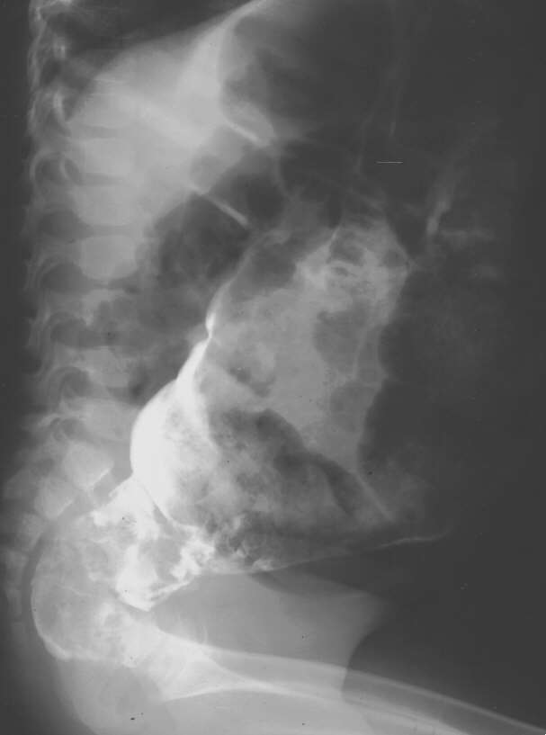
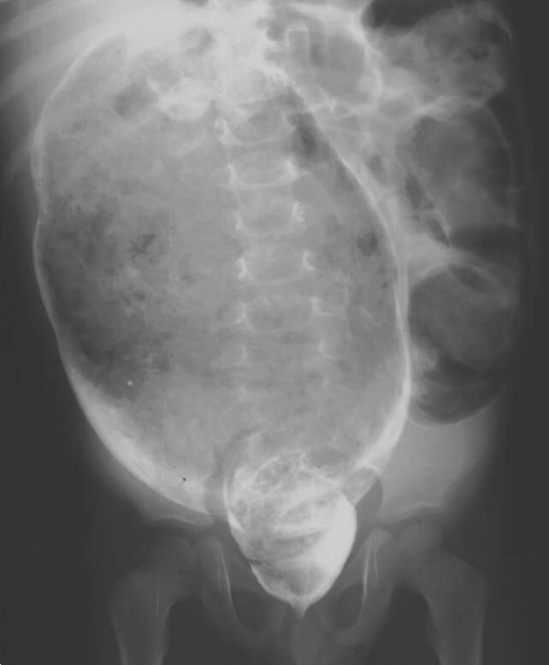
Notes:
However, many studies have documented that a maximum
of 10% of neonates with Hirschsprung disease will not have
a transition zone on contrast enema
the contrast study is not always
completely accurate in identifying the location of the pathologic
transition zone, with 12% of cases having a pathologic
transition zone which is different from the radiological
transition zone.

Slide 14
PAD
Engar ganglion frumur
myenteric plexus og submucosal plexus vantar
hypertrophieraðar taugar með háum styrk
acetyl cholinesterase

Slide 15
Meðferð
Stólpípur
eingöngu tímabundið - helst ef stutt segment
Aðgerð
one-stage eða byrjað að leggja út colostomíu (leyfa þöndum ristli að jafna sig)
Grunn prinsipp
fjarlægja allan sjúkan (aganglioneraða) þarm og tengja heilbrigðan þarm við anus
Notes:
Dilation á anastomosunni nauðsynleg í langan tíma eftir aðgerð

Slide 16
Aðgerðir
Swenson
Abdominal-perianal pull-through: colon sigmoidus dreginn út og saumaður við anus
Duhamel
Eðlilegur colon dreginn inn í aganlionic colon þar sem mucosan hefur verið strippuð af
Soave
Eðlilegur ristill dreginn í gegnum vöðvaslíf sjúka ristils
TERPT (nýjasta) ”Transanal Endo-Rectal Pull-Through”
https://www.youtube.com/watch?v=VyEnBn5DM3s
Notes:
In 1956, Bernard Duhamel of St Denis, France, described the retrorectal transanal pull-though procedure This concept was developed to preserve the nerves to the bladder and nervi erigente and left the aganglionic rectum in place. The normal
proximal bowel was brought down to the perineum through an incision 1.0 cm above the dentate line in the posterior rectal wall
In 1963, Soave of Genoa, Italy, described the endorectal pull-through procedure bringing the innervated bowel
down to the perineum through a muscular sleeve of the aganglionic rectum. Performing the mucosal stripping
dissection within the muscle wall reduced the risk of injury to the nerves to the bladder and nervi erigentes (From there, they contribute to the innervation of the pelvic and genital organs. The nerves regulate the emptying of the urinary bladder, control opening and closing of the internal urethral sphincter, influence motility in the rectum as well as sexual functions like erection).
Transanal endorectal pull-through (TEPT) was proposed by De La Torre-Mondragon in 1998 and has drastically changed the treatment of Hirschsprung's disease (HD) [1]. This minimally invasive procedure presents several advantages compared to classical pull-through techniques; it is a one-stage approach that can be conducted even during the neonatal period, previous colostomy is unnecessary, it is technically simple, and no intraperitoneal adherence or scarring is observed [2] and [3].

Slide 17
Pull through

Slide 18
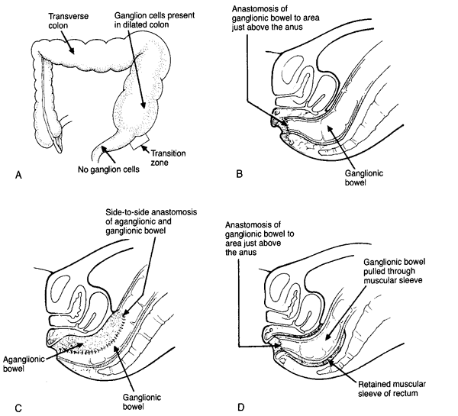

Slide 19
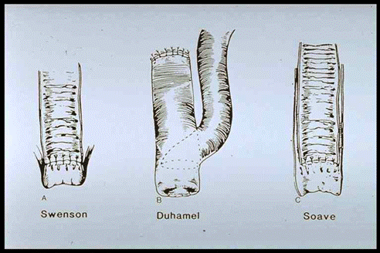

Slide 20
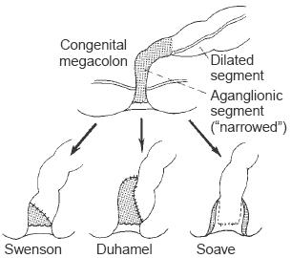

Slide 21
Duhamel

Slide 22
Fylgikvillar e. aðgerð
Possible complications of surgery include
anastomotic leki (5%)
anastomotic stricture (5-10%)
intestinal obstruction (5%)
pelvic abscess (5%)
sárasýkingar (10%)

Slide 23
Langtímaárangur
Hægðatregða
Hægðaleki (soiling)
Enterocolitis (0-40%)
Starfrænar truflanir í görn
Internal sphincter achalasia
-Botulinum toxin, myectomy
Betri function á unglingsárum
QoL verra á unglingsárum, betra hjá fullorðnum

Slide 24
Samantekt
Það vantar ganglionfrumur í hluta ristils sem þess vegna starfar ekki eðlilega, verður samandreginn og veldur hindrun.
Börnin skila illa eða ekki hægðum
Sýni frá ristli gefur greininguna
Meðferð gengur út á að fjarlægja óstarfhæfan þarm og tengja eðlilegan þarm við anus
Nöfn! Daninn og Svíinn (Halli og Svenni)

