Slide 1
Launeista
Cryptorchidism, retentio testes, retractile testes
Orri Þór Ormarsson
Barnaskurðlæknir
MD. PhD
Notes:
Launeista er bein þýðing á gríska orðinu cryptorchidism (cryptos; á laun/týndur/falinn og orchis; eista) (1) og á við eista sem hefur ekki gengið niður í pung með eðlilegum hætti by four months of age (or corrected age for premature infants)
Annað eða bæði eistu finnast ekki í púng.
Cryptorchid testes may be absent or undescended
Undescended testes (cryptorchidism) are testes that remain in the abdomen or the groin instead of descending into the scrotum. Retractile testes (hypermobile testes) have descended into the scrotum but can move back (retract) into the inguinal canal easily as a reflex response to stimulation

Slide 2
Hugtök
Absent testis – An absent testis may be due to agenesis or atrophy secondary to intrauterine vascular compromise (eg, prenatal testicular torsion), also known as the "vanishing testis syndrome" or testicular regression syndrome [2]. Boys who have bilaterally absent testes have anorchia. (See "Neonatal testicular torsion", section on 'Prenatal'.)
Retractile testes – Retractile testes are normal testes that have been pulled into a suprascrotal position by the cremasteric reflex. These testes can be brought into a dependent scrotal position and will remain there if the cremasteric reflex is overcome (eg, by holding the testis in the scrotum for at least one minute) [4]. (See 'Examination' below.)
Ascending testes – Ascending testes are noted to be in a scrotal position in early childhood and then to "ascend" and become undescended (ie, acquired undescended testes) [5-8].
Undescended testes – True undescended testes have stopped short along their normal path of descent into the scrotum (figure 1). They may remain in the abdominal cavity (picture 2) or they may be palpable in the inguinal canal (intracanalicular) or just outside the external ring (suprascrotal (picture 3)) [3].
Ectopic testes – Ectopic testes descend normally through the external ring but then are diverted to an aberrant position [3]. They may be palpable in the superficial inguinal pouch (most common), suprapubic region, femoral canal, perineum (picture 4), or contralateral scrotal compartment (least common) (figure 2).

Slide 3
Absent testes
Orsakast af
-Agenesis (mydast ekki)
-Intrauterin testicular torsio
Alltaf verður að staðfesta absent testes
Meðferð
-Unilat: engin, protesa
-Bilat: hormónagjöf
Notes:
Absent testis – An absent testis may be due to agenesis or atrophy secondary to intrauterine vascular compromise (eg, prenatal testicular torsion), also known as the "vanishing testis syndrome" or testicular regression syndrome [2]. Boys who have bilaterally absent testes have anorchia. (See "Neonatal testicular torsion", section on 'Prenatal'.)

Slide 4
Ascending testes
(acquired undescended testes )
Eistu sem voru niðri dragast upp
Hjá 1 árs – 10 ára
Vegna stutts sáðstrengs??
Meðferð: aðgerð
Notes:
Ascending testes – Ascending testes are noted to be in a scrotal position in early childhood and then to "ascend" and become undescended (ie, acquired undescended testes) [5-8].
Ascending testes or acquired undescended testes (Occasionally, a boy’s testicles migrate back inside the body even though they were properly housed in the scrotum at birth. This condition is known as acquired undescended testicles, or acquired cryptorchidism. It can occur when the boy is aged between one year and 10 years. The suspected cause is that the spermatic cords, which attach each testicle to the body, fail to grow at the same rate as the rest of the child. The comparatively short spermatic cords gradually pull the testicles out of the scrotum and into the groin.appear to be more common than congenital undescended testes, although this is controversial [8].

Slide 5
Retractile testicle
Eistu sem færast upp og niður (cremaster)
Óalgengt í fyrstu v. veiks cremasters reflex
Ekki aukin hætta torsio, krabbameini, eða minni frjósemi
Enginn meðferð en fylgja eftir
Notes:
Retractile testes – Retractile testes are normal testes that have been pulled into a suprascrotal position by the cremasteric reflex. These testes can be brought into a dependent scrotal position and will remain there if the cremasteric reflex is overcome (eg, by holding the testis in the scrotum for at least one minute) [4]. (See 'Examination' below.)
Retractility of the testis from the scrotum into a suprascrotal
position is normal in prepubertal boys. It is brought
about by the contraction of the cremaster muscle in
response to temperature, stimulation of the superficial
reflex via the genital branch of the genito-femoral nerve,
and by extreme emotion such as anxiety
After birth, the testes are relatively large due to the
testosterone surge between 10 days and 3 months, and at
this time the cremasteric reflex is weak meaning retractile
testes in newborn boys are uncommon.
retractile testes are at no increased risk for
acute torsion over normal testes
the literature with regard to fertility
outcomes of retractile testes is limited to epidemiological
series of infertile adult males with obvious selection bias
and low level evidence that is difficult to interpret

Slide 6
Undescended testes
& Ectopic testes
Eistu til staðar en
-of hátt uppi - undescended
-á vitlaus um stað - ectopic
Notes:
Usually the undescended testis is in the inguinal canal but sometimes it is within the abdomen. About two thirds of undescended testes descend on their own by 4 months of age in full-term infants or, for premature infants, by 4 months after the date they would have been born if they were not premature. Testes that remain in the abdomen at birth are much less likely to descend on their own.
Undescended testes – True undescended testes have stopped short along their normal path of descent into the scrotum (figure 1). They may remain in the abdominal cavity (picture 2) or they may be palpable in the inguinal canal (intracanalicular) or just outside the external ring (suprascrotal (picture 3)) [3].
Ectopic testes – Ectopic testes descend normally through the external ring but then are diverted to an aberrant position [3]. They may be palpable in the superficial inguinal pouch (most common), suprapubic region, femoral canal, perineum (picture 4), or contralateral scrotal compartment (least common) (figure 2).

Slide 7
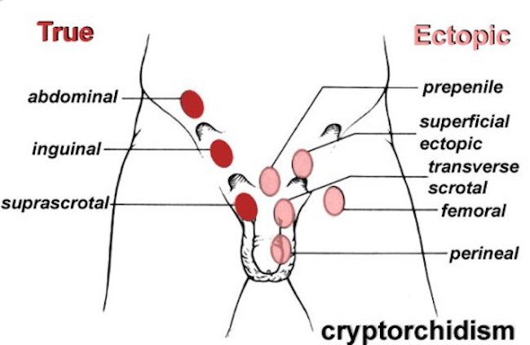
Undescended/Ectopic testes
Staðsetning
Notes:
Usually the undescended testis is in the inguinal canal but sometimes it is within the abdomen. About two thirds of undescended testes descend on their own by 4 months of age in full-term infants or, for premature infants, by 4 months after the date they would have been born if they were not premature. Testes that remain in the abdomen at birth are much less likely to descend on their own.
After birth, the testes are relatively large due to the
testosterone surge between 10 days and 3 months, and at
this time the cremasteric reflex is weak meaning retractile
testes in newborn boys are uncommon.
retractile testes are at no increased risk for
acute torsion over normal testes
the literature with regard to fertility
outcomes of retractile testes is limited to epidemiological
series of infertile adult males with obvious selection bias
and low level evidence that is difficult to interpret

Slide 8
Algengi
Launeista er á meðal algengustu meðfæddra galla hjá drengjum
3-5% allra nýfæddra en
30% fyrirburum
10% bilateral
Flest koma niður en við 1 árs aldur sitja um 1% eftir (af öllum börnum)
Notes:
About 3-5 of every 100 (3%-5%) boys who are born at full term (9 months) have an undescended testis at birth. However, about 30 of every 100 boys (30%) born prematurely have an undescended testis. Boys whose family members had undescended testes also are more likely to have the condition. Usually only one testis fails to descend, but in about 10% both testes are affected.
Most (approximately 70 percent) congenitally undescended testes descend spontaneously so that by one year of age the prevalence is approximately 1 percent, which is similar to that in adults [22,27,28].
Í nágrannalöndum okkar hefur tíðni launeista verið að aukast án þess að skýring á því sé ljós. Til dæmis var lýst 35% aukningu á nýgengi launeista hjá nýburum og 93% aukningu hjá þriggja mánaða gömlum drengjum á 34 ára tímabili í enskri rannsókn (3). Sama þróun hefur átt sér stað í Bandaríkjunum en í Danmörku hefur nýgengi hins vegar haldist stöðugt en þar er nýgengi launeista með því hæsta sem þekkist (8% hjá nýburum)
EPIDEMIOLOGY AND RISK FACTORS — Between 2 and 5 percent of full-term and approximately 30 percent of premature male infants are born with an undescended testis [22-26]. Most (approximately 70 percent) congenitally undescended testes descend spontaneously so that by one year of age the prevalence is approximately 1 percent, which is similar to that in adults [22,27,28]. Ascending testes (acquired undescended testes) appear to be more common than congenital undescended testes, although this is controversial [8].
The prevalence of cryptorchidism varies geographically. In a prospective cohort study, cryptorchidism was present in 9 percent (95% CI 7.3-10.8) of newborn boys in Denmark but only 2.4 percent (95% CI 1.7-3.3) of newborn boys in Finland [29]. Whether this variation is due to genetics or environmental factors (eg, endocrine disrupters, lifestyle factors), or the clinical definition of undescended versus retractile testis, is unclear.
Risk factors for undescended testes include prematurity, being small for gestational age at birth, and birth weight <2.5 kg [23,24,30-32]. Prenatal exposure to endocrine disruptors (eg, diethylstilbestrol, pesticides) also has been associated with cryptorchidism in some studies [33].

Slide 9
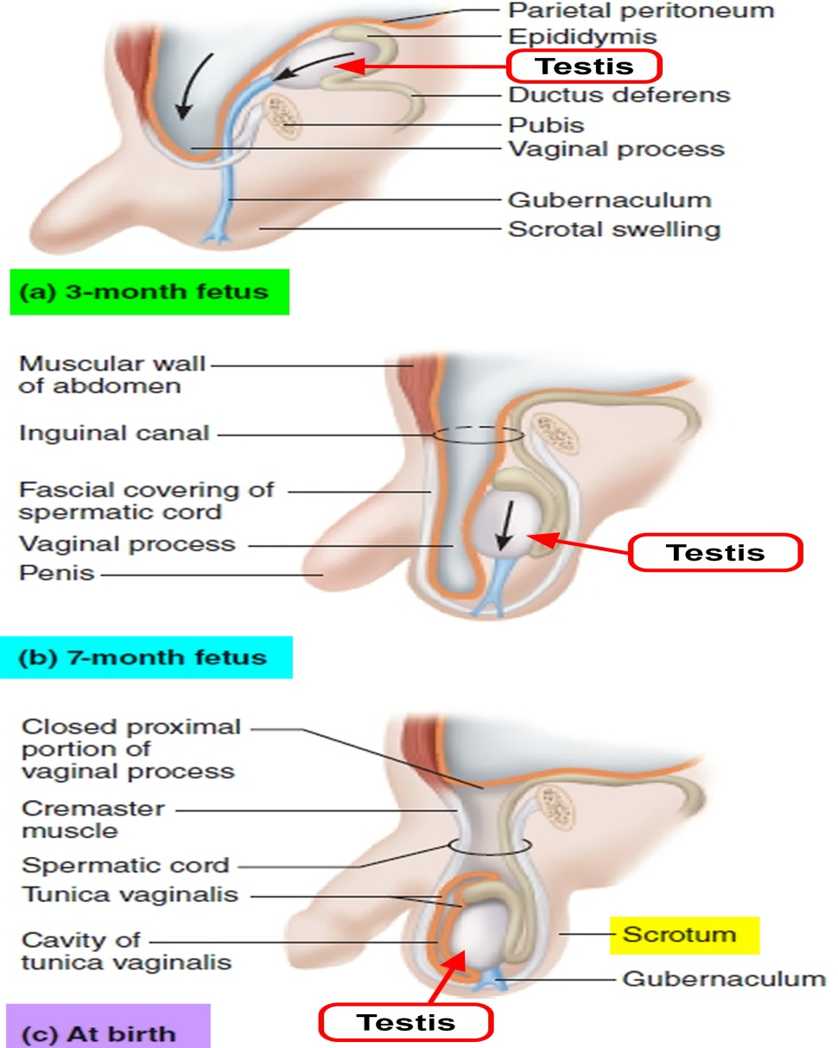
Fósturfræði
(A) 2 mán.
Eistað myndast á urogenital ridge
(B) 3 mán.
Coelomic holið bungar niður í scrotal búnguna og myndar processus vaginalis
(C) 7 mán.
Eistun færast í púng leitt áfram af gubernaculum
Notes:
The mechanisms responsible for normal testicular descent are not well understood. The intra-abdominal phase of descent is thought to be androgen-independent and mediated by descendin (figure 1) [9,10]. Passage through the inguinal canal, which begins in the 28th week of gestation, is believed to result from interaction between mechanical, hormonal, and neurotransmitter effects. Changes in abdominal pressure, patency of the processus vaginalis, gubernacular regression, androgens, gonadotropins, müllerian inhibiting substance (MIS), and calcitonin gene-related peptide are all thought to play a role [9-15].

Slide 10
Orsök
Ekki vitað, allt sem truflar eðlilegan gang mála!
Hormónar
skortur á Gonadotropin in utero
Skortur á Müllerian inhibiting substance (MIS)
Aukið estradiol
Gubernaculum samdráttur-verður ekki?
Opnun processus vaginalis
Utanaðkomandi þættir: eiturefni, alkóhól, reykinga
Erfðir og gen: Insulin-like factor 3
Samfara öðrum göllum/syndromum: hypospadiasis, nára herniur, abd. wall defekts, Down´s, Prade-Willi, Noonan, Kallmann
Notes:
The pathogenesis of undescended testes is less well understood than that of normal testicular descent [16]. Alterations in any of the factors that contribute to normal testicular descent may theoretically result in undescended testes.
Gonadotropin deficiency in utero, decreased MIS, and increased expression of estradiol in the placenta have been proposed as contributing factors [17-20].
Orsök launeista er ekki þekkt en flest bendir til að margir þættir komi við sögu. Helstu áhættuþættir eru neðanrás (hypospadias), nárakviðslit og sér í lagi fyrirburður en 20-30% fyrirbura og tæplega fjórðungur léttbura (<2500g) eru með launeista (4, 6, 7). Áhætta er jafnframt aukin við keisarafæðingu og ef aðrir meðfæddir gallar eru til staðar (8-10).
Orsök launeista er ekki þekkt en flest bendir til að margir þættir komi við sögu. Helstu áhættuþættir eru neðanrás (hypospadias), nárakviðslit og sér í lagi fyrirburður en 20-30% fyrirbura og tæplega fjórðungur léttbura (<2500g) eru með launeista (4, 6, 7). Áhætta er jafnframt aukin við keisarafæðingu og ef aðrir meðfæddir gallar eru til staðar (8-10).
Cryptorchidism occurs more commonly among patients with congenital disorders of testosterone secretion or action (e.g. Kallmann syndrome- where there is a defect in the development of certain nerve pathways in the brain that help testosterone secretion), abdominal wall defects, neural tube defects, cerebral palsy, and various genetic syndromes including trisomy 18 (three copies of chromosome 18) and Noonan syndrome.
Severely premature infants can be born before descent of testes. Low birth weight is also a known factor.[7]
A contributing role of environmental chemicals called endocrine disruptors that interfere with normal fetal hormone balance has been proposed. The Mayo Clinic lists "parents' exposure to some pesticides" as a known risk factor.[7][8]
Risk factors may include exposure to regular alcohol consumption during pregnancy (5 or more drinks per week, associated with a 3x increase in cryptorchidism, when compared to non-drinking mothers.[9] Cigarette smoking is also a known risk factor.[7]
Family history of undescended testicle or other problems of genital development.[7]
Cryptorchidism occurs at a much higher rate in a large number of congenital malformation syndromes. Among the more common are Down syndrome[7] Prader–Willi syndrome, and Noonan syndrome.
In vitro fertilization, use of cosmetics by the mother, and preeclampsia have also been recognized as risk factors for development of cryptorchidism.[10]

Slide 11
Greining
Saga
Skoðun
Ómun
CT/MRI
Notes:
In a retrospective series of 447 nonpalpable testes, at the time of surgery, 41 percent were atrophic or absent; 20 percent were intra-abdominal; 30 percent were intracanalicular; and 9 percent were in other locations (suprascrotal, upper scrotum, superficial inguinal pouch, perineum)

Slide 12
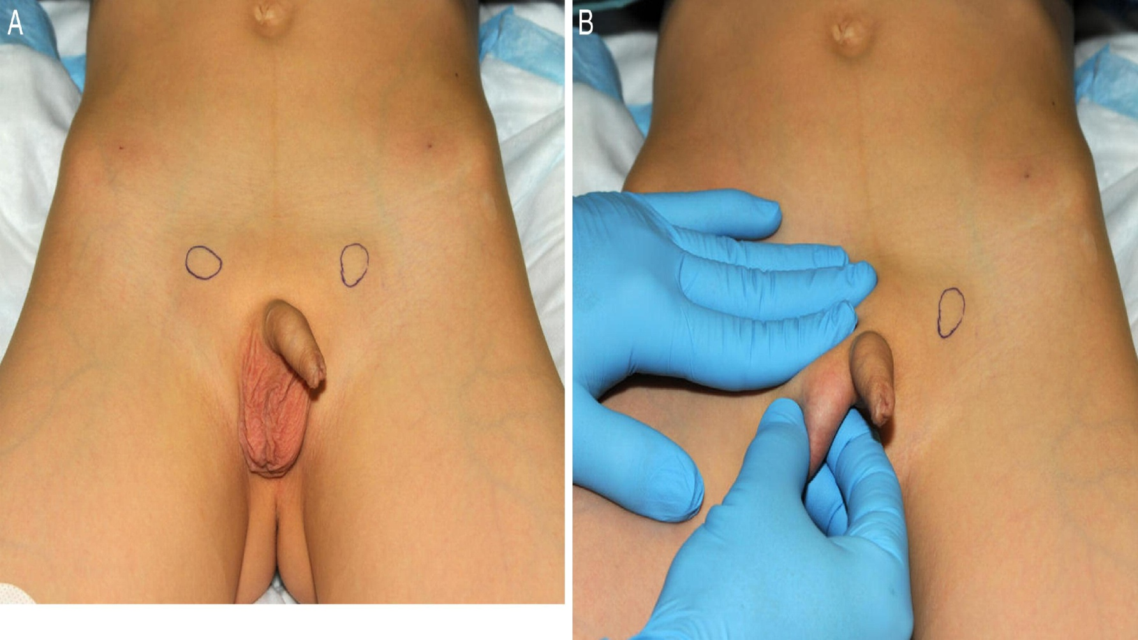
Skoðun

Slide 13
Fylgikvillar
Ófrjósemi
Krabbamein
Uppásnúningur (torsio testes)
Áverkar
Hernia
Testosteron (androgen) skortur
Sjálfsmynd
Notes:
Helstu fylgikvillar launeista eru ófrjósemi og krabbamein í eistum. Um 10% þeirra sem greinast með krabbamein í eistum hafa sögu um launeista (11, 12). Einnig eru launeistu viðkvæmari fyrir snúningi (torsio testis) og útsettari fyrir áverkum ef þau eru staðsett í náragangi eða ofan lífbeins þar sem þau geta klemmst á móti harðri mótstöðu (6).
It is accepted that
congenital UDT have an increased relative risk of germ cell
malignancy that may be approximately 5e10 times that of
the normal population [

Slide 14
Cryptorchidism og ófrjósemi
Skiptir máli hvenær eistað færist (er fært) niður í pung og hvort bæði eistu eru ofan pungs
breytingar á eista við 6-12 mánaða aldur
-seinkaður þroski, og fækkun, germ cells
-skemmdir á sáðpíplum
-fækkun Leydig fruma (<testosteron)
-Varanlegt að einhverju leyti
Aukin tíðni frjósemisvanda, sérstaklega ef bilat
Færri sáðfrumur, minna motility
Aðgerð fyrir 1 árs aldur

Slide 15
Cryptorchidism og eistnakrabbamein
Talsvert aukin (4-40x) hætta á myndun germ-cell krabbameins í eista
Algengast að birtist milli 15 og 45 ára
Talið skýra 10% alls eistnakrabbameins
Intraabdominal eista er 4x líklegra en inguinal eista
10-25% þessara tilvika verða í contralateral, eðlilega niðurgengnu eista!
Færsla eistans í pung minnkar þessa hættu aðeins lítillega en eykur hins vegar líkindi þess að þreifa fyrirferð í eista
Cryptorchidisma er stærsti áhættuþáttur myndunar testicular carcinoma in situ um (8% allra með cancer m. sögu um cryptorchidisma)
Notes:
Canser uppgötvast seinna ef í nára eða intraabdominalt

Slide 16
Meðferð
Fyrir 1 árs aldur
Opinn aðgerð
-um nára
-scrotalt eða parascrotalt
Laparoscopi (Fowler-Stephens procedure)
Microvascular aðgerð
Hormónameðferð
hCG er notað ( í USA). Virkar stundum ef eistað er staðsett efst í pung eða distalt í inguinal canal
Talið geta minnkað frjósemisvanda seinna meir

